Slide 1

42 Helper
OFFER HELP. REQUEST HELP. HAVE TEST EVALS

Slide 2
HAVE FUN WITH YOUR PEERS

Slide 3
Future?
Better Test Eval Implementation
Multiple Campus Support
RESTRICT PEOPLE FROM OFFERING HELP IF THEY DIDN’T DO SET PROJECT ON THEIR OWN
Improve COLORING SYSTEM (PROJECT COLOR MATCHES DUCK COLORS)
IMPLEMENT IT INTO THE NEW STREAK SYSTEM with profits

Slide 4
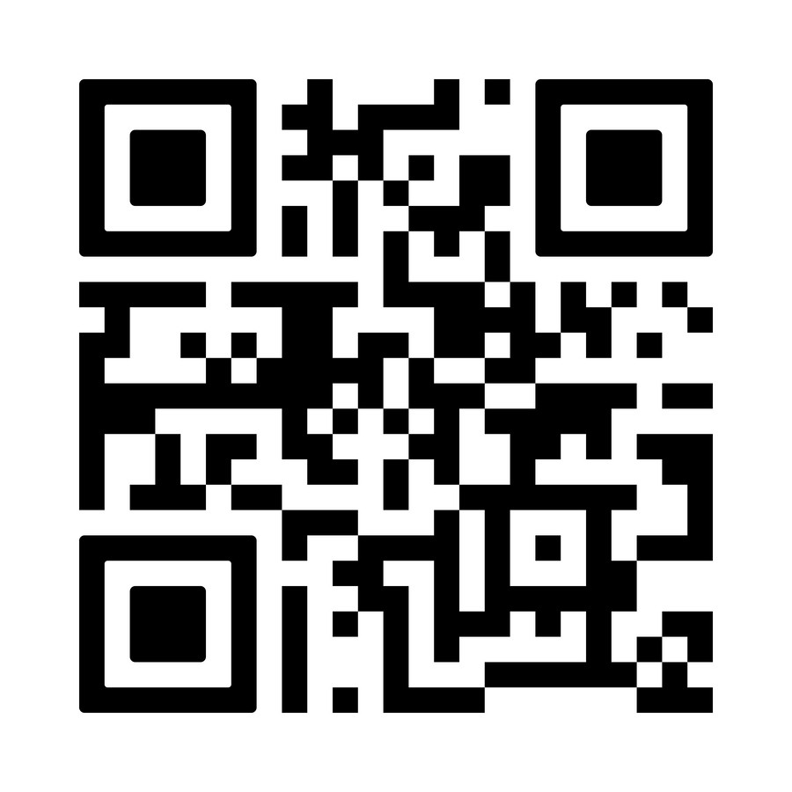
Try it out... it’s already live!
https://42helper.reptudn.uk
PS: .uk was the cheapest

